Slide 1
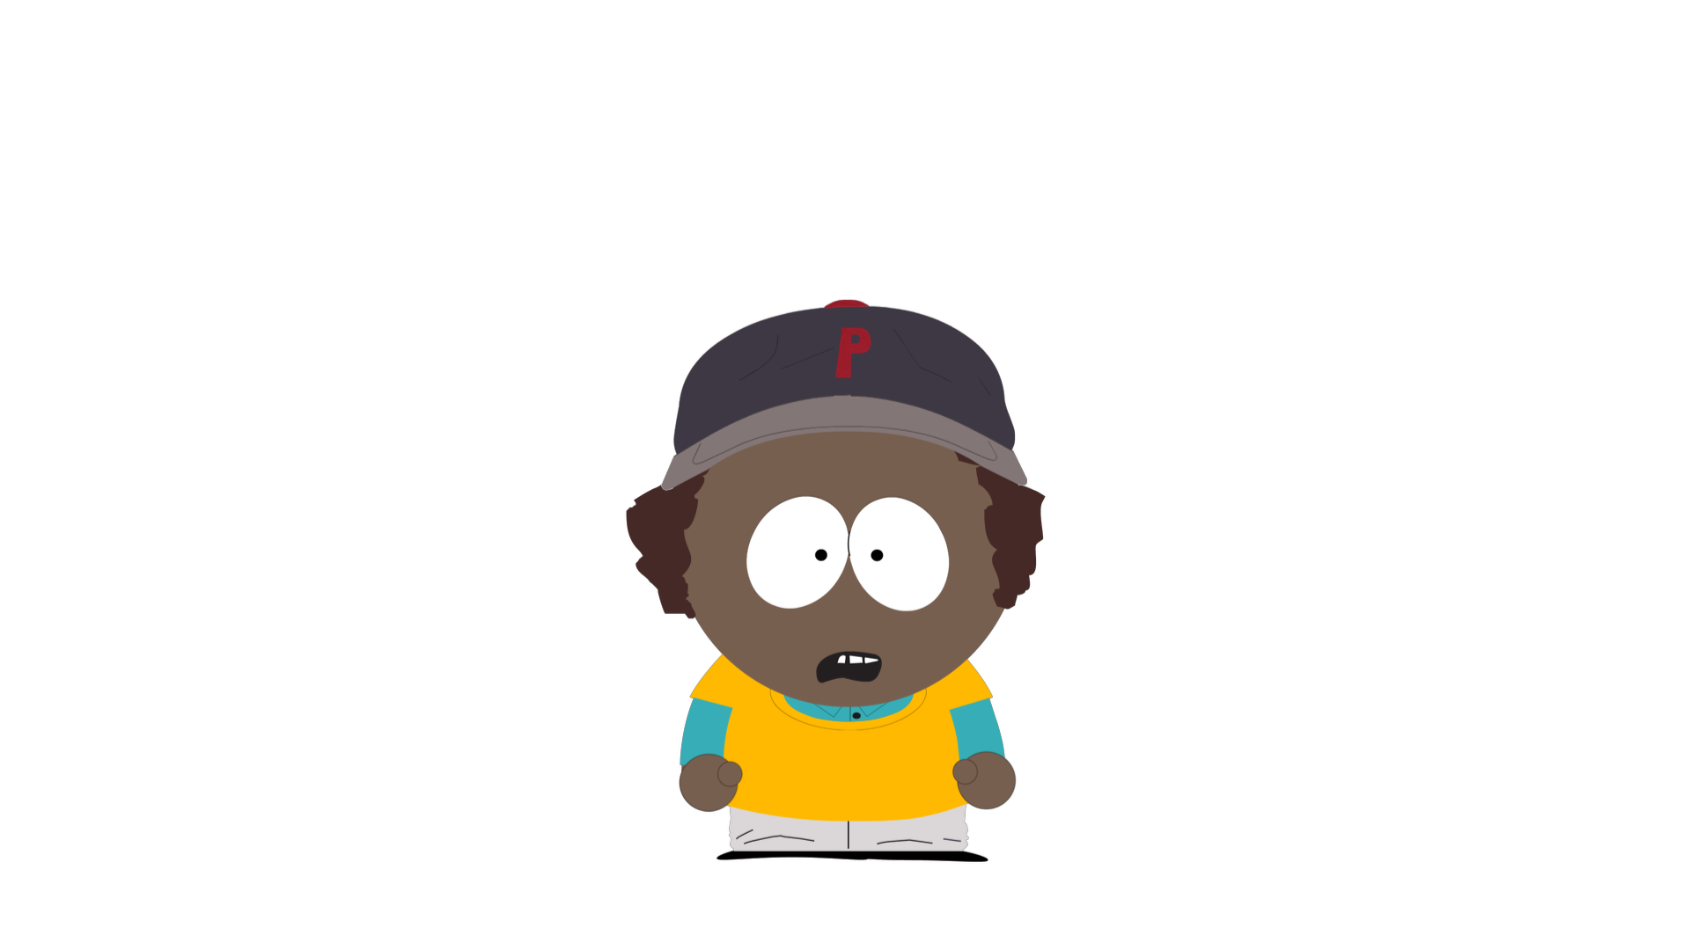
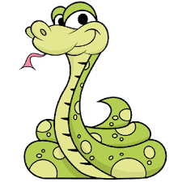
This is Blake. Blake sees a snake in her backyard, and s/he feels scared. Blake heard from her/his friend that s/he could start to get a stomach ache from being scared.
Notes:
This is Blake. Blake sees a snake in her backyard, and s/he feels scared. Blake heard from her/his friend that s/he could start to get a stomach ache from being scared.

Slide 2
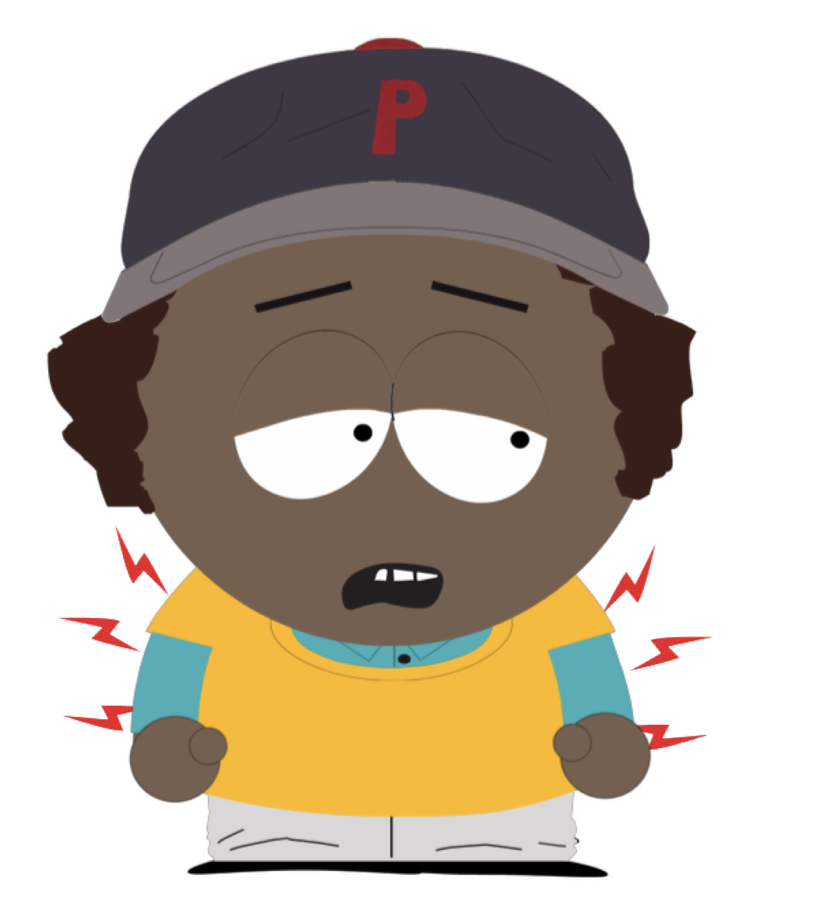
Can that happen? Do you think Blake can get stomach ache just from feeling scared? Or do you think Blake cannot get a stomach ache just from feeling scared?
Notes:
Can that happen? Do you think Blake can get stomach ache just from feeling scared? Or do you think Blake cannot get a stomach ache just from feeling scared?

Slide 3
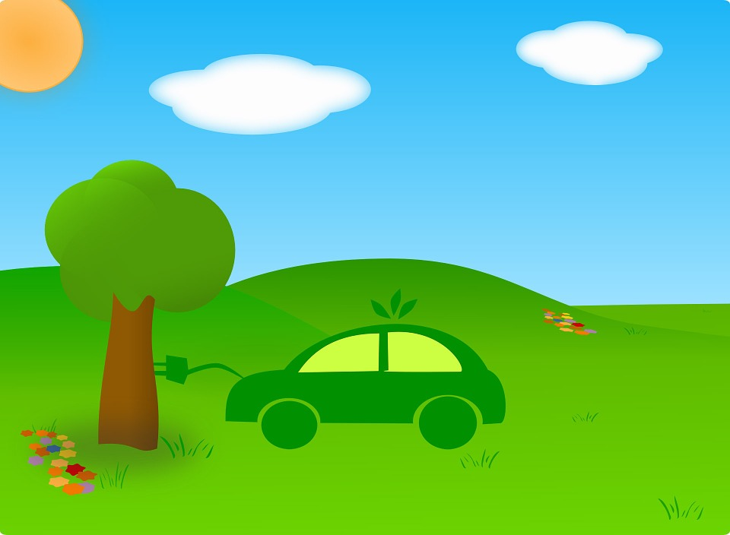
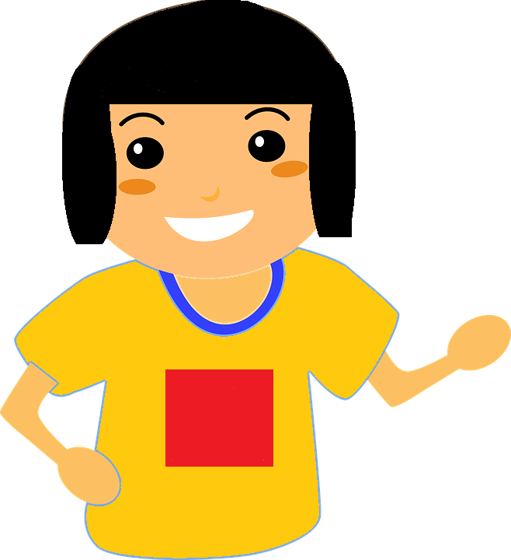
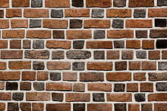

This is Jesse. Jesse is at the park. Jesse picks up a feather. Jesse brushes the feather against a wall. Jesse’s friend tells Jesse that if s/he keeps brushing the feather on the wall, the wall will break.

Slide 4
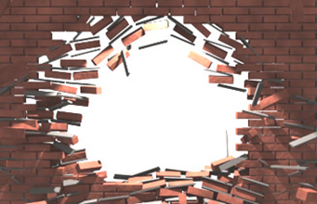

Can that happen? Can Jesse break the wall with a feather? Or can that not happen? Can Jesse not break the wall with a feather?

Slide 5
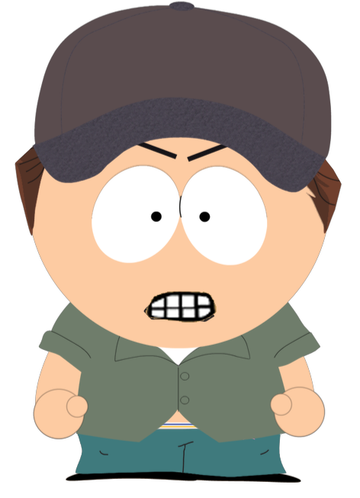
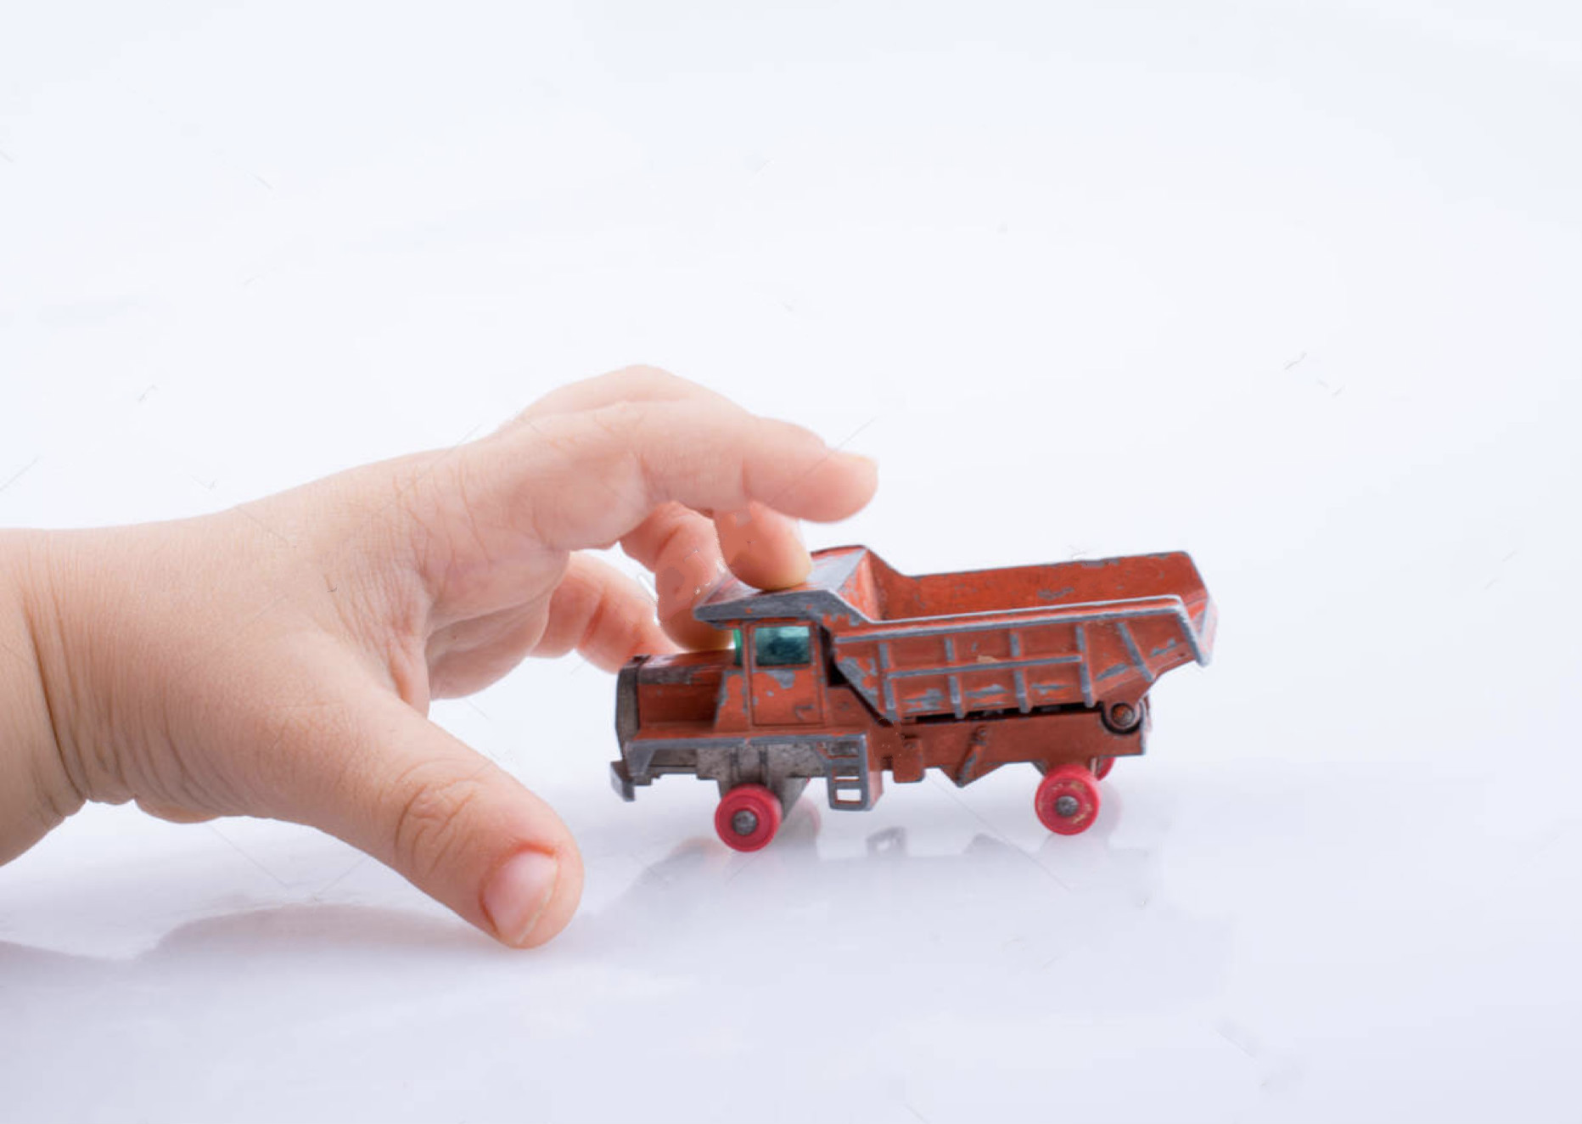
This is Alex. Alex is angry because her/his classmate took her/his toy away. Alex’s friend told her/him that if s/he feels angry, her/his fists might start to clench. That is, it can feel like s/he’s squeezing her/his fingers really tight together like this.

Slide 6
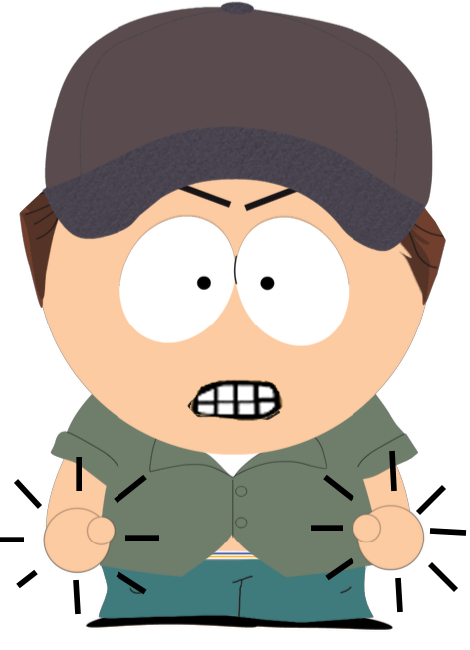
Can that happen? Can Alex’s fists clench just from feeling angry? Or can that not happen? Can Alex fist not clench just from feeling angry?

Slide 7
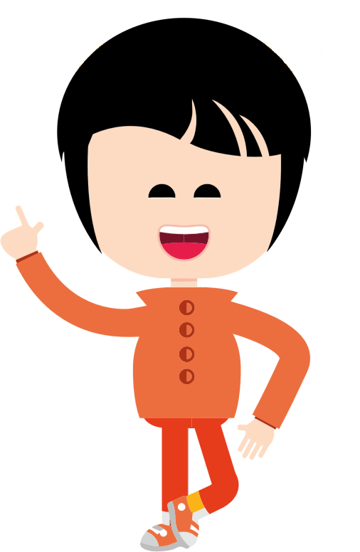
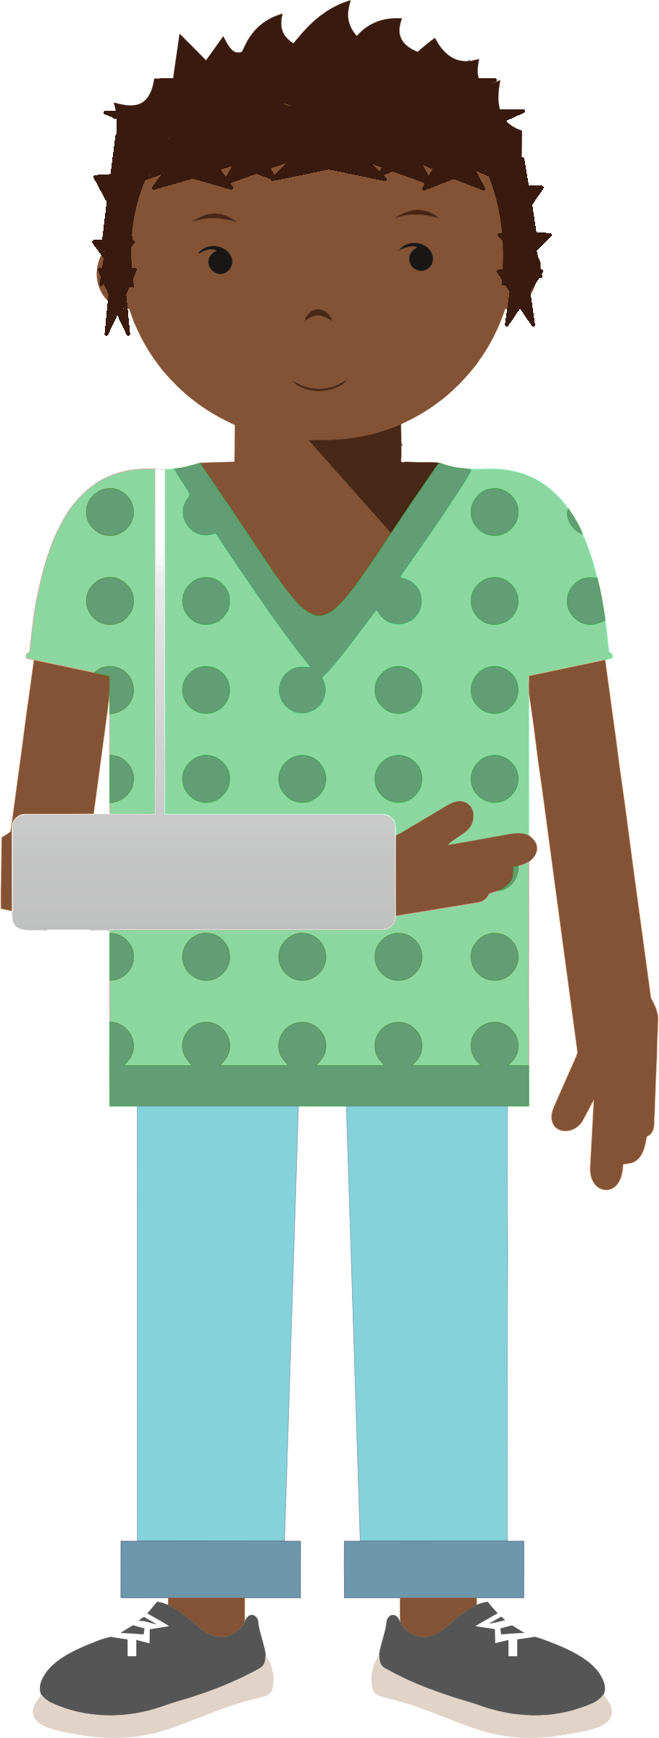
This is London. London’s friend Carter has a broken arm. London is going to visit Carter at her/his house. London’s friend says that s/he could have a broken arm just from visiting Carter.

Slide 8
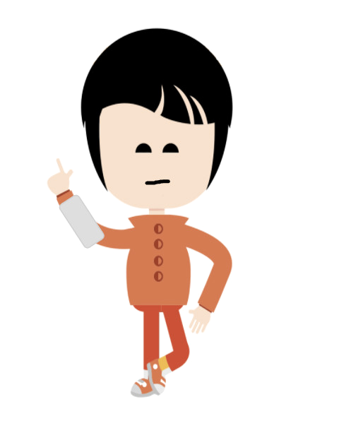
Can that happen? Can London get a broken arm just from visiting Carter who has a broken arm? Or can that not happen? Can London not get a broken arm just from visiting Carter who has a broken arm?

Slide 9
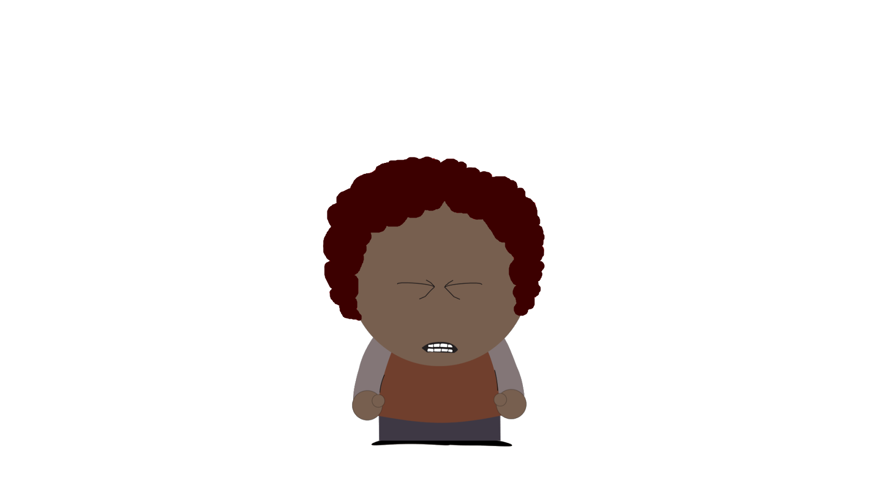
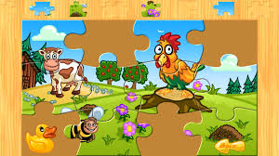
This is Ari. Ari is trying to solve a puzzle, but s/he fails. Ari feels frustrated. Ari has heard from her/his friend that if s/he feels frustrated s/he could start to get a headache.

Slide 10
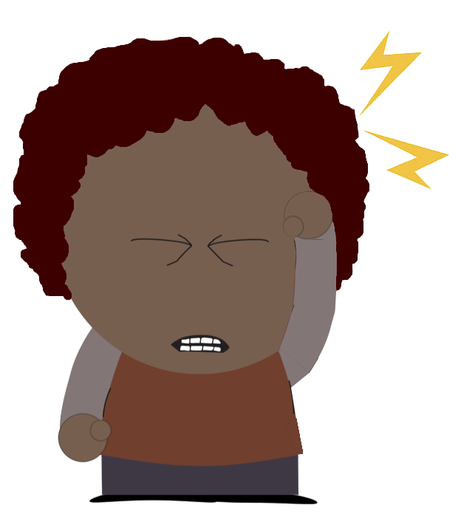
Can that happen? Can Ari can get a headache just from feeling frustrated? Or can that not happen? Can Ari not get a headache just from feeling frustrated?

Slide 11
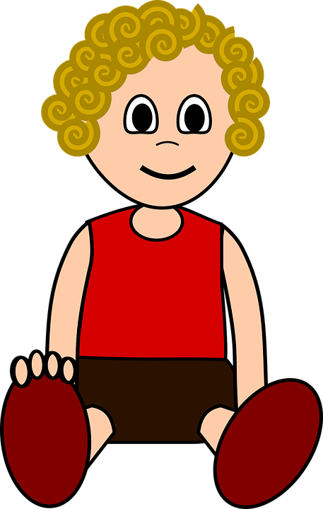

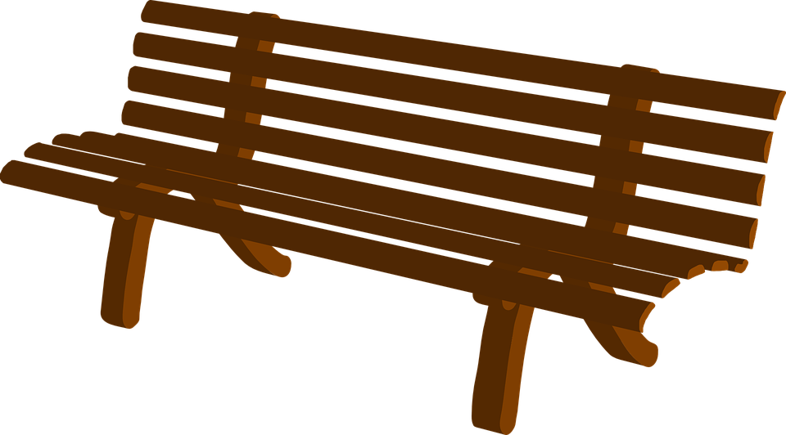

This is Andy. Andy is jumping off the bench. Andy is jumping from the bench to the sandbox. Andy’s friend tells Andy that if s/he wants s/he can jump off the bench and just float in the air for a long, long time, not coming back down or touching anything .

Slide 12
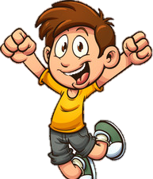
Can that happen? Can Andy stay floating in the air for a long time when s/he jumps? Or can that not happen? Can Andy not stay floating in the air for a long time when s/he jumps?

Slide 13
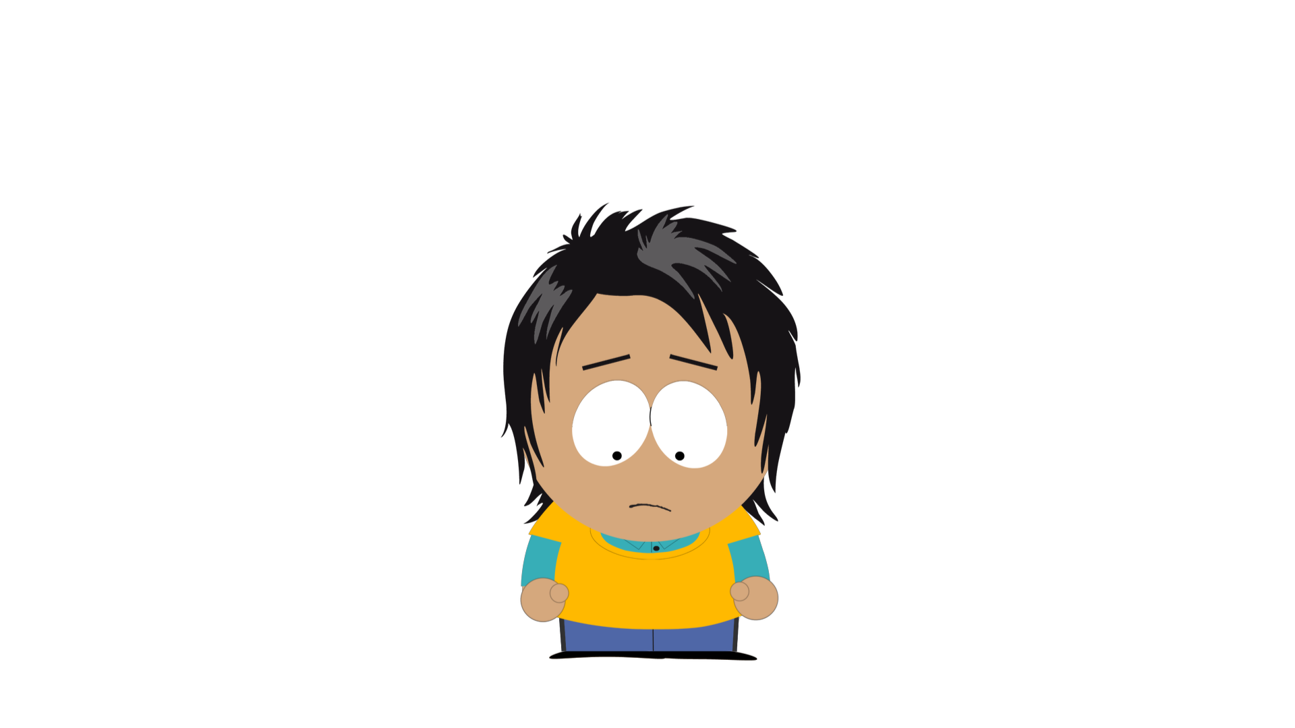
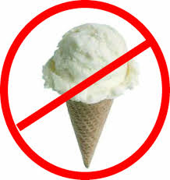
This is August. August is sad because her/his mom said s/he cannot have ice cream. August heard from her/his friend that if s/he keeps being sad s/he could get a chest pain. That is, s/he could get a sore spot in her/his chest here.

Slide 14
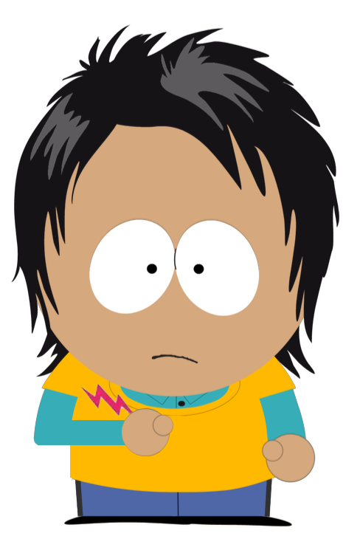
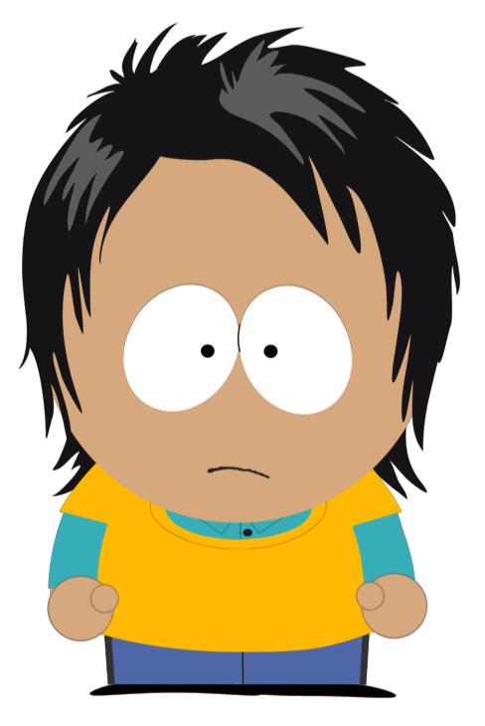
Can that happen? Can August get chest pain just from feeling sad? Or can that not happen? Can August not get chest pain just from feeling sad?

Slide 15
This is Aiden. Aiden feels bored because s/he doesn’t have anything to do today. Aiden’s friend says that if s/he feels bored s/he could start to feel tired.

Slide 16
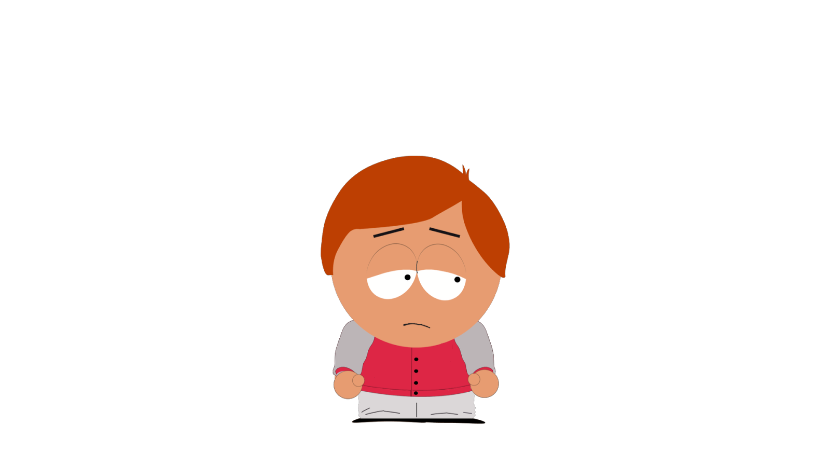
This is Aiden. Aiden feels bored because s/he doesn’t have anything to do today. Aiden’s friend says that if s/he feels bored s/he could start to feel tired.

Slide 17
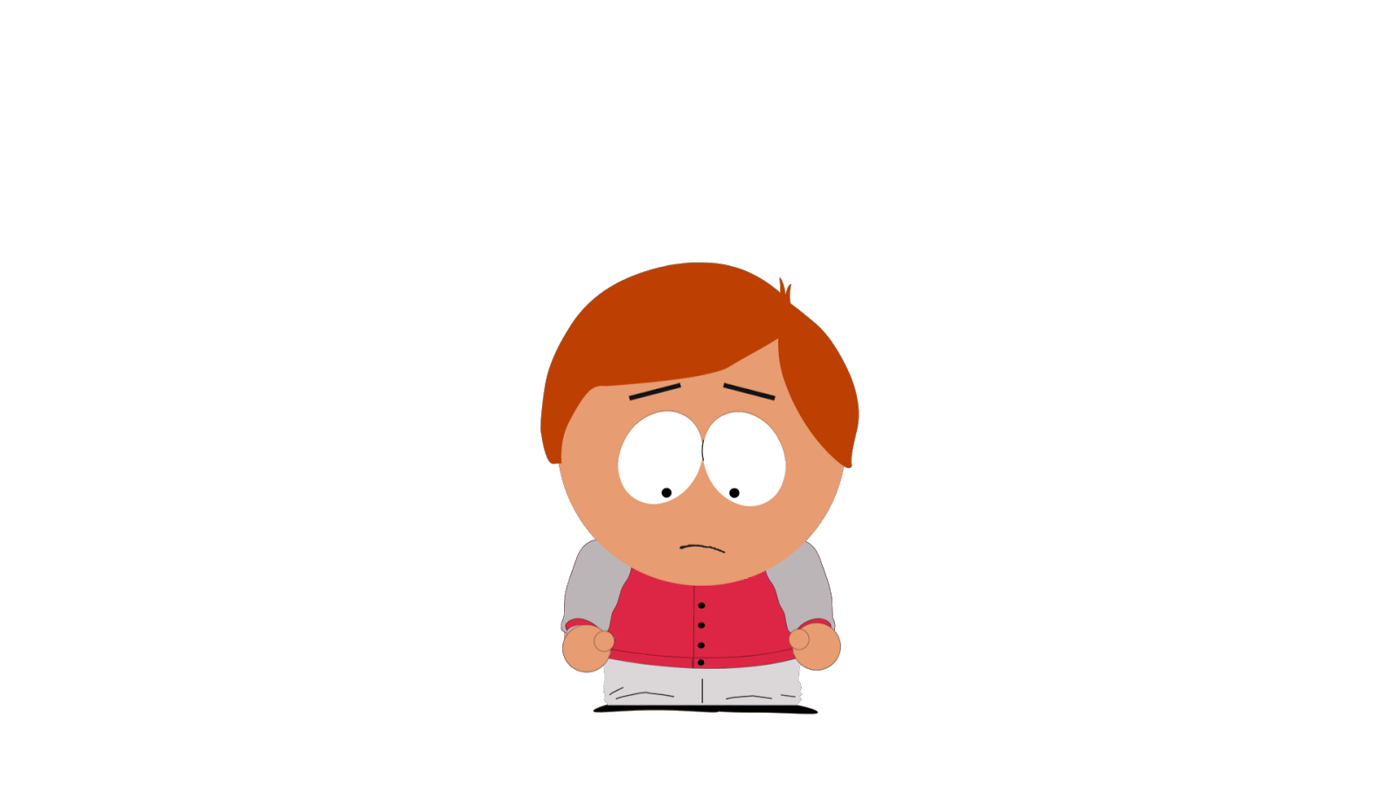
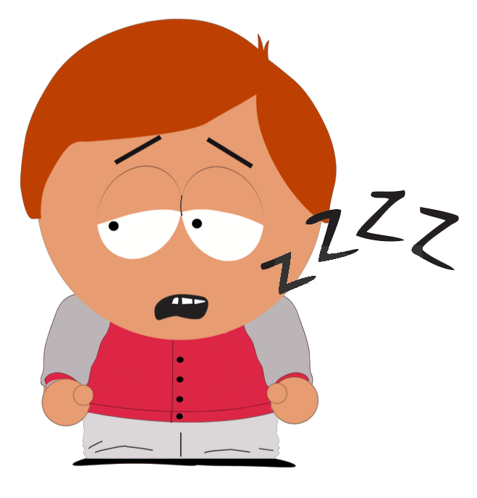
Can that happen? Can Aiden feel tired just from feeling bored? Or cam that not happen? Can Aiden not feel tired just from feeling bored?

Slide 18
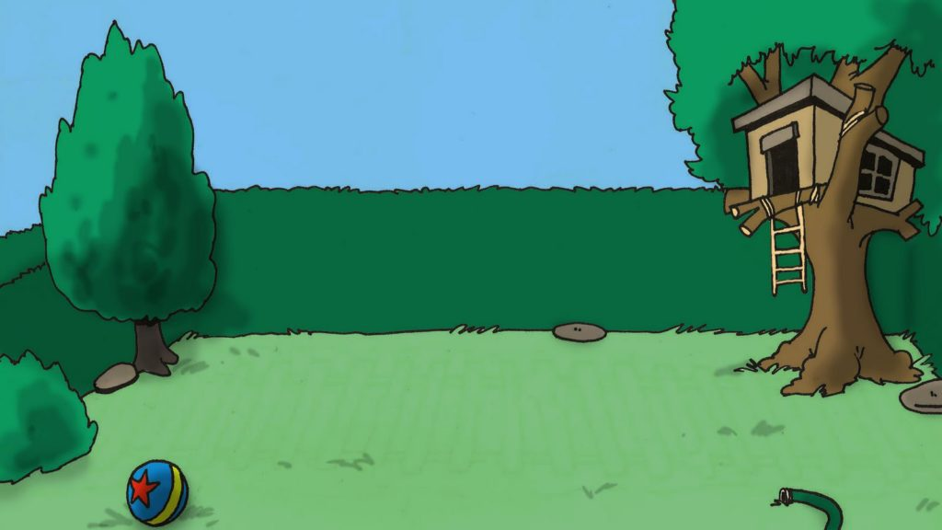
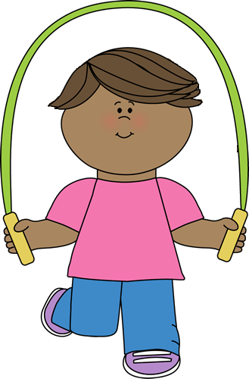
This is Taylor. Taylor is in her/his backyard. Taylor is jumping rope. Taylor has been jumping rope for a long time. Taylor’s friend tells Taylor that if s/he keeps jumping rope, s/he will get very tired.

Slide 19



Can that happen? Can Taylor get tired just from jumping rope for a long time? Or can that not happen? Can Taylor not get tired just from jumping rope for a long time?

Slide 20
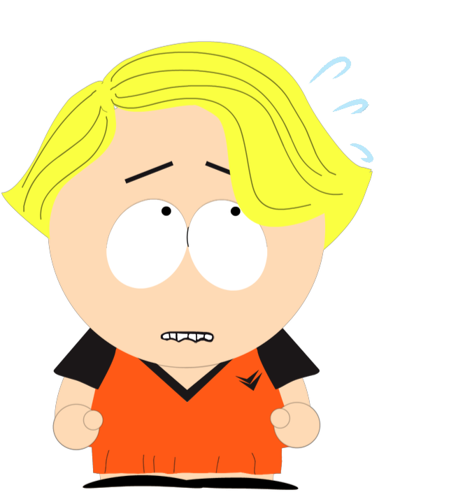
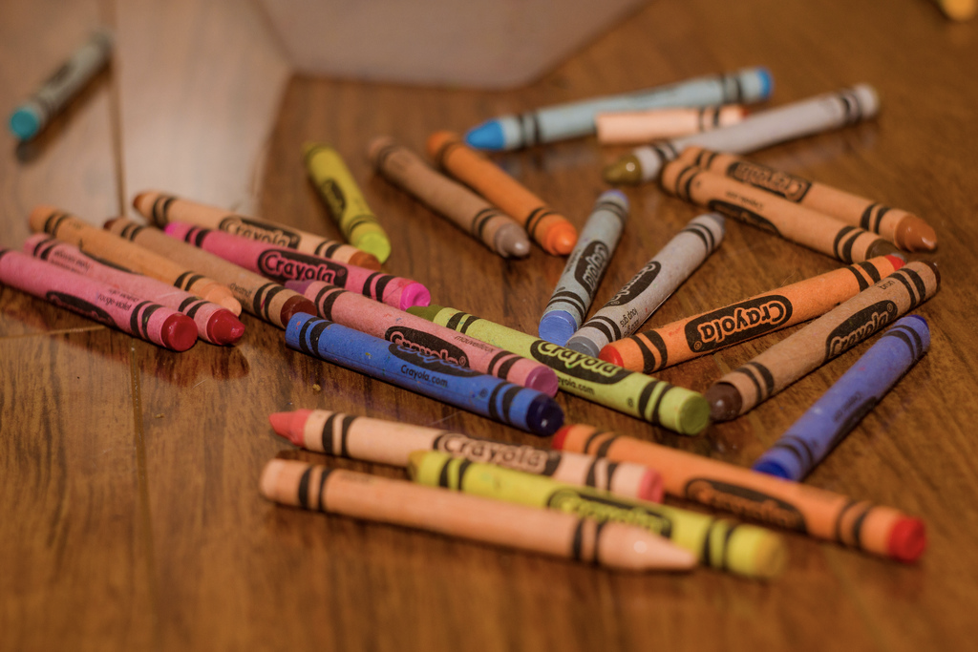
This is Charlie. Charlie spills all her/his crayons in front of her class, and s/he feels embarrassed. Charlie has heard from her/his friend that if s/he feels embarrassed, her/his cheeks could turn pink.

Slide 21
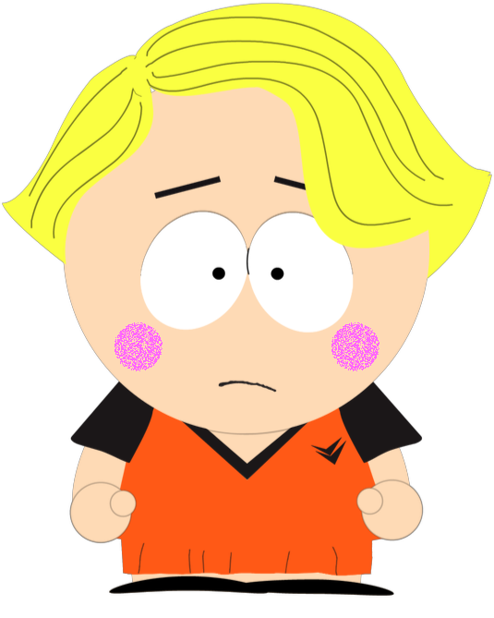
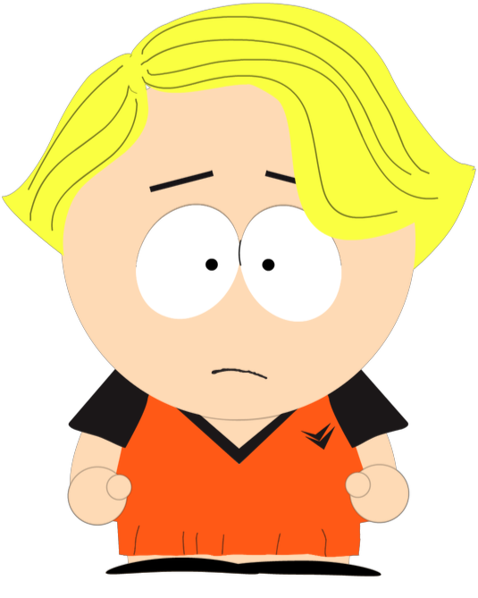
Can that happen? Can Charlie’s cheeks turn pink just from feeling embarrassed? Or can that not happen? Can Charlie’s cheeks not turn pink just from feeling embarrassed?

Slide 22
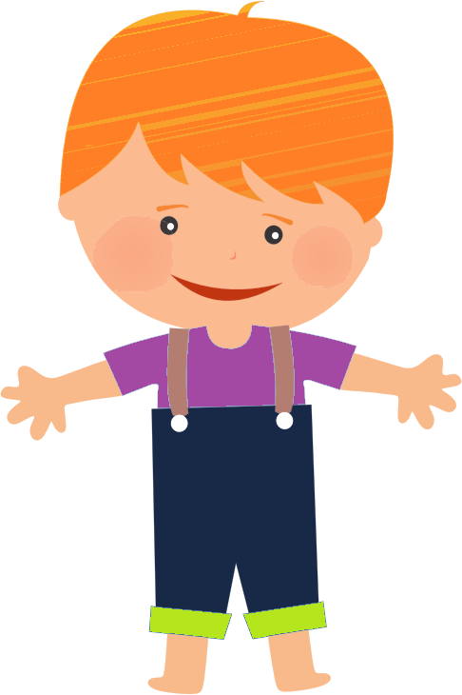
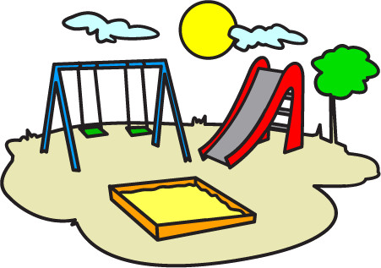

Slide 23


Gray is throwing a ball. Gray is throwing the ball near a lake. Gray’ friend says that if s/he throws the ball into the water it will make a big splash.

Slide 24

Can that happen? Can Gray make a splash just by throwing the ball into the water? Or can that not happen? Can Gray not make a splash just by throwing a ball into the water?

